Slide 1

Prediction of early dropouts from online courses
Harika Dondapati ¹ , Lakshmi Priya Komalli ¹, Tejaswi Koneru ¹, Jaynica Nunna ¹
Guided By: Dr. Sumalatha Saleti
Department of Computer Science and Engineering SRM University - AP Amaravati, Andhra Pradesh, India ¹.

Slide 2

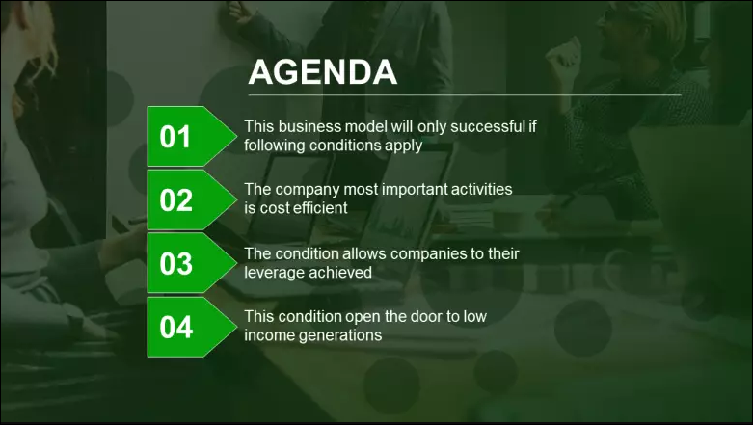
Introduction to the topic
Literature Review
Proposed Methodology
Conclusion
05
Results

Slide 3

Abstract:
Predicting student performance in massive open online courses is critical for reaping the benefits of many phases, such as learning outcomes and making timely improvements. We proposed Decision trees, Random forest, Knn, Polynomial SVM, AdaBoost, Gradient Boost, and Logistic Regression algorithms, with the use of these Machine Learning Models. We highlight some solutions that have been used to address the dropout problem, provide an analysis of the challenges of prediction models and offer some valuable insights and recommendations that could lead to the development of effective and useful machine learning solutions to address the MOOC dropout problem.

Slide 4
Introduction:
Massive Open Online Courses(MOOCs) have given an opportunity to all global Learners to avail quality education through online mode.
Nowadays MOOC learners are increasing globally but the completion rates of chosen courses are very low and dropout rates are very high.
Many people who joined the MOOCs are confused about whether to complete their education or not.
There is a lack of understanding of learning behavior through the online mode of education. The results after the course completion are very low because there is a lack of interaction between the learners and the instructors.

Slide 5
The students who are pursuing their courses online are in large numbers, so the information is stored in the large data, including the student ID, years, enrollment date and time, course ID, gender, and the number of courses.
The dropout rates of the given data set and the accuracy is predicted by some of the Machine learning techniques such as Random Forest Classifier, Decision tree, Logistic regression, KNN classifier, polynomial SVM, Gradient boost, AdaBoost, MLP Regressor. Finding the accuracy, precision, and ROC Curve for each machine learning algorithm.
The goal of our research is all about finding the accuracy and precision of the MOOC course each year and predicting the learners from dropping out of the online courses.

Slide 6
Literature review
One major issue is the high percentage of dropouts. The majority of students who enroll in online courses do not complete them and drop out midway.MOOC development might be limited by various factors. It's important to be able to predict whether or not a student will drop out.
Classification
[1]. Herbert Schildt 5th edition, Dietel and Dietel 4thedition
People that extract features in this procedure must be familiar with the dataset and have some subject knowledge. When using feature engineering to extract features, various iterations of feature extraction and testing are required. As a result, the process takes a long time and is unreliable. In feature engineering, on the other hand, methodologies for extracting features are adapted to the features of datasets. Strategies that work for one type of dataset may not work for another type of dataset. New algorithms for extracting features must be created manually if new types of datasets exist.
Rahul Katarya;Jalaj Gaba;Aryan Garg;Varsha Verma; (2021).
This research focuses on utilizing ML and RF to predict MOOC dropout to predict student dropout.Machine Learning (ML) is a powerful technology that may be used in Learning Analytics to uncover hidden patterns of student involvement in MOOCs, offering advantages above standard statistical analysis

Slide 7
.
Students' dropout in an online course was also identified using logistic regression. This approach outperformed logistic regression, Support Vector Machine (SVM), and KNN in terms of precision, recall, specificity, and accuracy during validation . Eight machine learning algorithms were used to examine students with a high chance of failing in order to detect their performance early.
Random forest, Gradient boost, ADA boost, and MLP Regressor were the most effective algorithms for early student identification. The accuracy was determined to be 95%. Furthermore, data processing was discovered to be crucial in improving the efficiency of ML algorithms. Predictive models have been described in previous studies, however various constraints limit their use to a single learning platform.
The prediction is made using the Random Forest Model technique in Machine Learning (ML), which is analyzed using validation measures such as accuracy, precision, recall, F1-score, and the Receiver Operating Characteristic (ROC) curve. With an accuracy of 95 percent, precision of 96 percent, recall of 96 percent, and F1-score of 96 percent, the built model can predict whether students will drop out or continue in the MOOC course on any given day. Shapley values were used to explain the contributing features and interactions for the model prediction.

Slide 8
.
Significant features that assist MOOC learners and designers in developing course material, course structure, and delivery were established using a Decision Tree (DT) algorithm .To evaluate the in-course behavior of online students, three MOOC datasets were subjected to a variety of machine learning techniques. According to the authors, the models utilized could be useful in predicting crucial features in order to reduce attrition.
These studies aid in the prediction of student outcomes, including dropout rate; however, none of them forecast students who are at danger of dropping out at a later point in the course. As a result, we present the RF model with features such as including average, standard deviation, variance and skewnes.
The literature review presented in this article is primarily divided into two categories: methodologies and objectives. The strategies are described first in this article since they are used to achieve the goals discussed in each reference. These strategies are then implemented using a variety of algorithmic ways.
Objectives: The objectives are linked to the students' learning processes' interests and concerns.
Techniques: The techniques take into consideration various algorithms, methods, and tools that process data in order to assess and anticipate the sign of things to come.

Slide 9
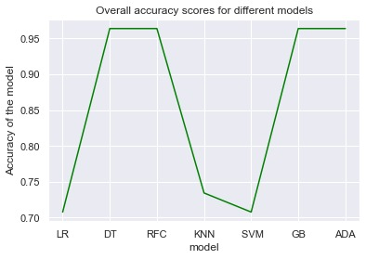
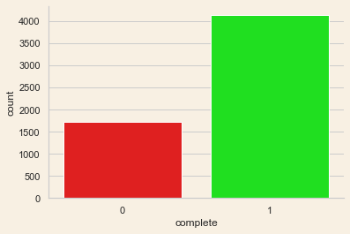
Methodology - Machine Learning Models
We have used the Random Forest, Decision tree, Gradient Boost, Ada Boost, Knn, Svm, Logistic Regression Machine Learning Models to find the accuracy for Prediction of early dropouts from online courses.
Here, We got Random Forest, Decision tree, and
Gradient Boost techniques that combine the prediction
From different algorithms together which are having
High accurate prediction in among choosen seven
Models.
This Graph From the ASU Dataset, the
Completion, of course, is high when
compared to dropouts from the courses.
v

Slide 10
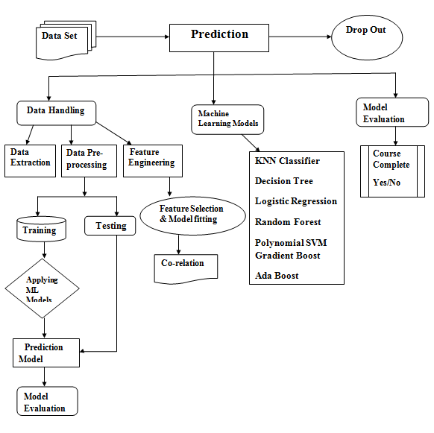
In the previous studies over the Dropout rate prediction everyone has taken the consideration of the student behavior over a particular course which will definitely lead to lower accuracy because the student has done many courses and his behavior depends on all of the course he has done.
In order to overcome the low accuracy
rate we have taken some statistical
Measures such as Standard deviation,
skewness and kurtosis as a Rolling
window over the student course completion
percentage over different Subjects Enabling
to us to train the model with The features of
student depending on different Subjects there
by increasing the accuracy of prediction.

Slide 11
Dataset Description:
Prediction of early dropouts from online courses conducted by the Student course dropout prediction dataset are included in the collection of data like student_id, years, entrance_test_score, enroll_date_time, course_id, Course_progress, online, gender, international From 2016 to 2020, data from the personality math class College Algebra and Solving Problems presented by EdPlus on the MOOC program Open edX platform at Arizona State University (ASU) was considered. The availability of this data is restrictive Data has been collected through EdPlus and is accessible with permission from the authors. EdPlus is a service that is provided by EdPlus. The family educational and privacy act protects student information (FERPA).

Slide 12
Future Scope Many academics have been interested in Drop out prediction model’s in machine learning research. The use of drop out prediction model In MOOC course has been proposed the estimation and execution methods of the initial mass for students are first presented as per the DPM in MOOC, and also proposed the trainings utmost region definition sample, as well as their customization and implementation. When we apply the suggested DPM to forecast MOOC student’s prediction condition, we first capture the student’s clickstream dataset and represent every student as just a multi-dimensional feature vector based on their clickstream data. Many challenges must be overcome in DPM research learn on machine learning, such as distance learning between learner, training sample quality, training sample imbalance, feature extraction and representation. In this project we simply constructed the machine learning model using eight algorithms. As a result, in future, we will be able to create various machine learning techniques and various data attributes.

Slide 13
Conclusion Academic institutions face a difficult problem in predicting which students will abandon their studies. Attrition among college students is a long term process, necessitating the use of longitudinal modeling method. Throughout this paper, we propose a survival analysis-based methodology for assessing students who are at high risk of dropping out of their higher education programme at an early stage. Extending various statistical methods to the study of attrition has allowed us to investigate the periodic character of attrition behaviors in our research. The statistical modelling approaches employed in this study are targeted on the problem of early student dropout. Other factors that influence the probability of senior students dropping out can be included in the suggested framework to model late student dropout. Feed-forward neural networks, support vector machines, and probabilistic ensemble simplified fuzzy ARTMAP are three machine learning techniques used in the method.

Slide 14
The method integrates their estimations using three separate choice schemes to overcome individual technique flaws in detecting dropout pupils. Students participating in online courses are more likely to drop out than those enrolled in a traditional classroom setting. The key difficulty for corporate universities is employee motivation to study and the inability to choose one's preferred learning method. It could lead to ineffectiveness and a misalignment of employee requirements with organization's strategic goals. As a result, improving the effectiveness and efficacy of student learning is critical for both environmental and economic reasons for both public and commercial institutions. The goal of this study was to provide an in-depth look at the factors that influence student dropout rates (SDP).

Slide 15
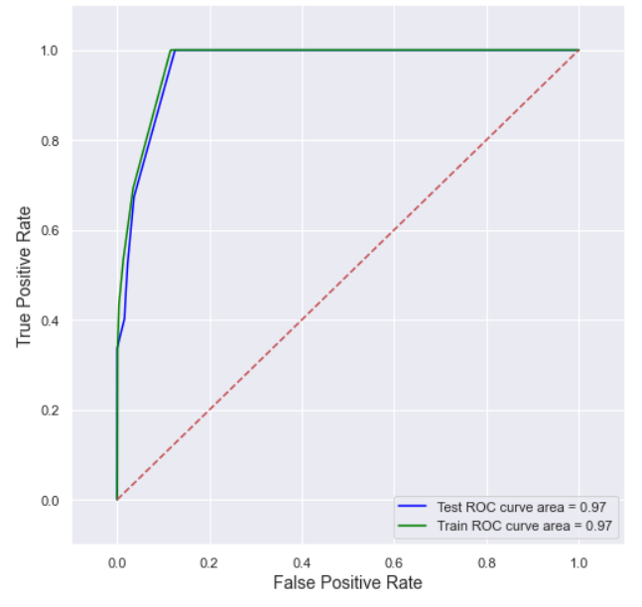
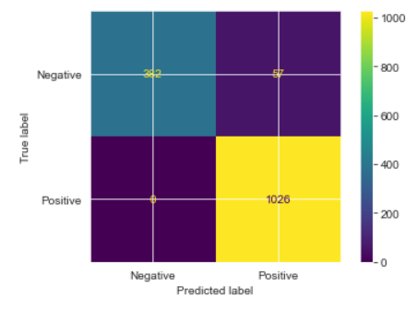
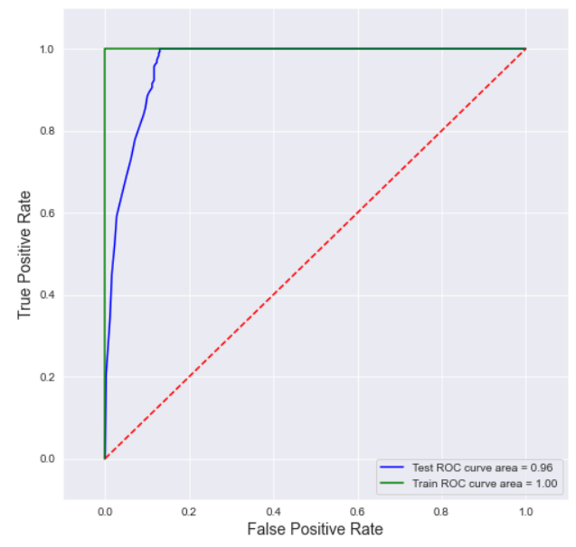
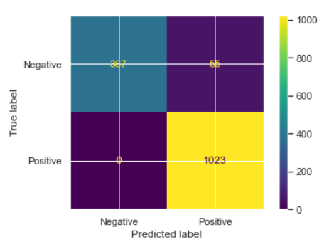
Results
Decision tree Confusion Matrix And Roc Curve
Random Forest Roc Curve And Confusion Matrix

Slide 16
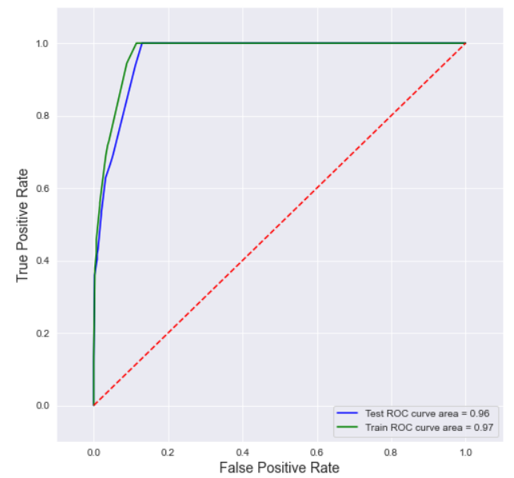
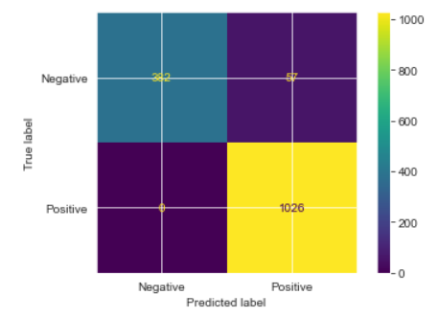
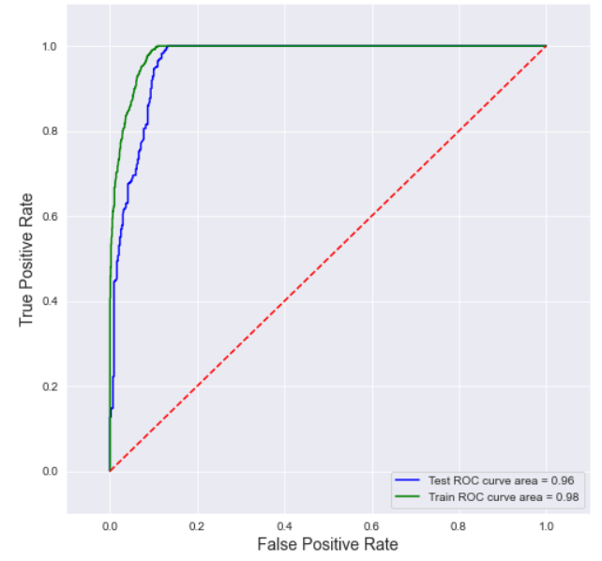

Gradient Boost Confusion Matrix And Roc Curve
Ada Boost Roc Curve And Confusion Matrix

Slide 17
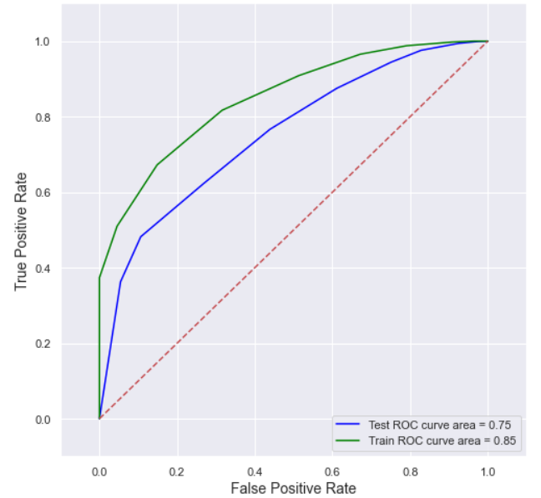
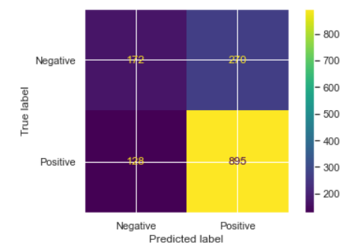
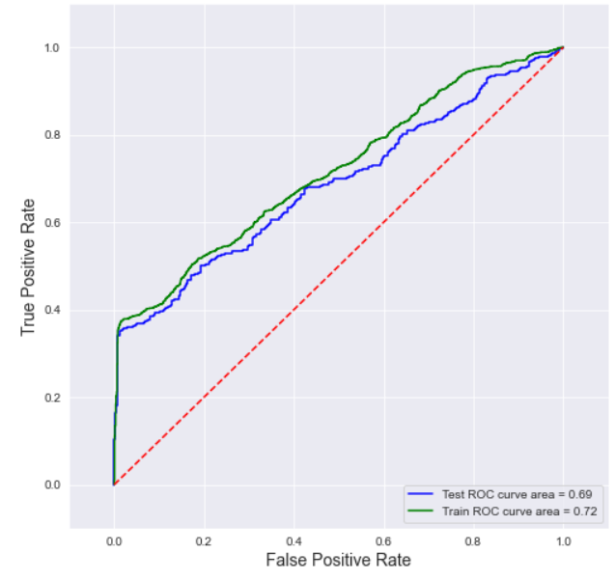
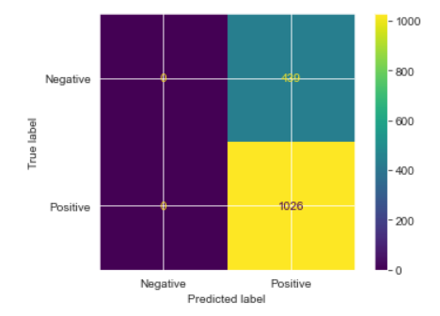
K-nearest neighbor Confusion Matrix And Roc Curve
Support Vector Machine Roc Curve And Confusion Matrix

Slide 18
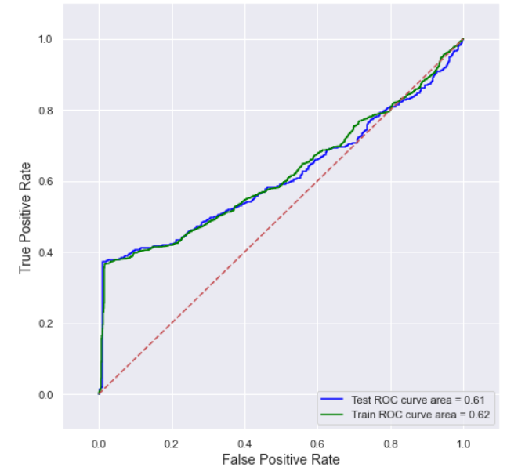
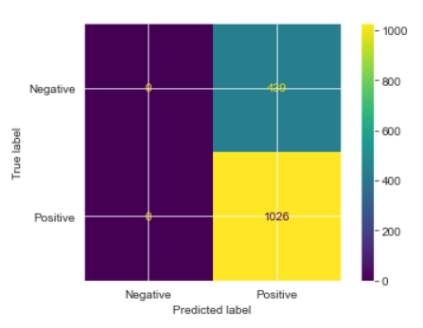
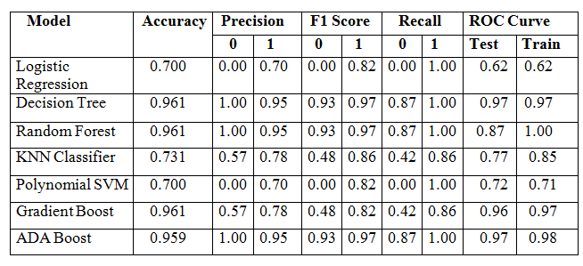
Logistic Regression Confusion Matrix And Roc Curve

Slide 19



